Slide 1

​ Performance Tuning,
Maintenance & Troubleshooting, Threat Model & Protection​

Slide 2

What is Performance Tuning

Slide 3

Introduction to Performance Tuning
Performance tuning refers to the systematic process of adjusting system configurations to achieve optimal system performance.

Slide 4
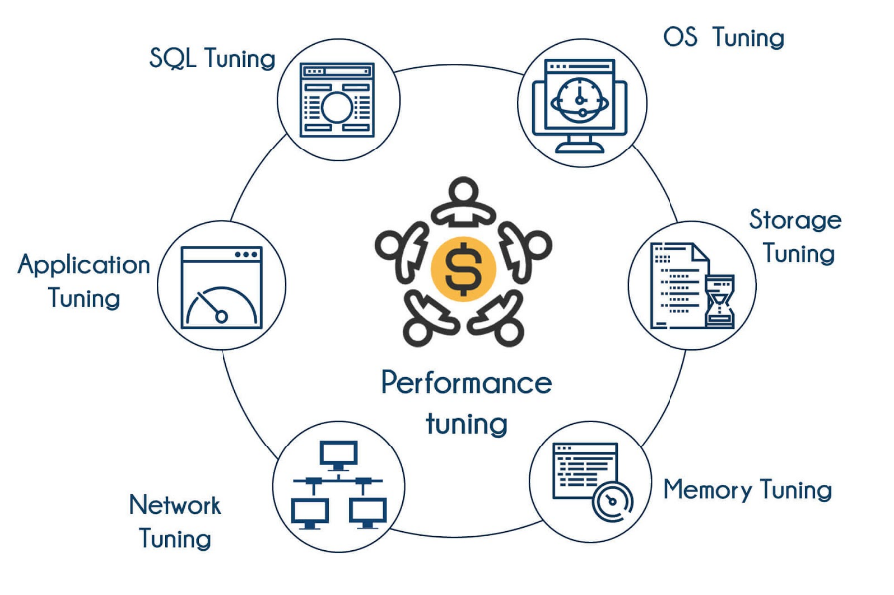
Performance Tuning
Objective: The goal is to make the system faster, more efficient, and responsive, by optimizing various components like CPU, memory, disk, network, and kernel.
Why Tune Linux?
Handle increased workloads efficiently.
Ensure system stability under peak load.
Reduce latency, improve throughput.

Slide 5
Monitor System Performance
Use Command Line Tools:
top: Displays CPU and memory usage.
htop: An enhanced version of top with a better interface.
iostat: Monitors CPU and input/output statistics.
vmstat: Reports on virtual memory, processes, and CPU activity.
sar: Collects, reports, or saves system activity information.

Slide 6
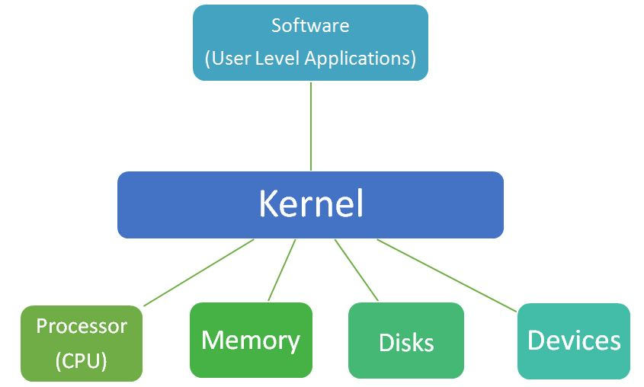
Kernel Tuning for Performance
What is the Kernel?
The kernel is the core component of the Linux operating system, managing hardware resources (CPU, memory, disk) and enabling communication between hardware and software.
Why Tune the Kernel?
Tuning the kernel helps optimize how the system handles resources and processes, which can lead to better system performance, responsiveness, and efficiency.

Slide 7
Step 1 - Identifying and Viewing Kernel Parameters
^{Identifying Parameters:}
Determine which kernel parameters affect your workload (e.g., memory, CPU scheduling, I/O, networking).
Common commands: sysctl -a (to view all parameters) and sysctl <parameter> (to view a specific parameter).
^{Viewing Current Settings:}
Example command: sysctl vm.swappiness shows the current swappiness value.
sysctl: adjusts kernel parameters dynamically.

Slide 8
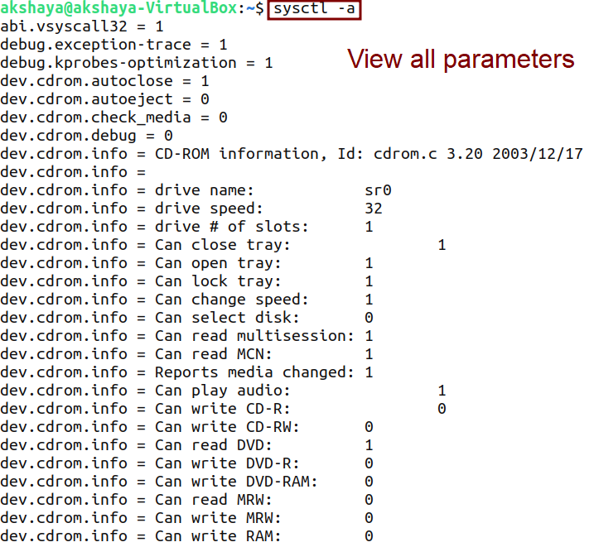
Viewing Kernel Parameters

Slide 9
Step 2 - Modifying Kernel Parameters
Temporary Changes:
Use sysctl -w <parameter>=<value> to modify a kernel parameter temporarily.
Example: sudo sysctl -w vm.swappiness=10.
Permanent Changes:
To make changes permanent, edit /etc/sysctl.conf file
Add or modify lines such as vm.swappiness = 10 to persist changes across reboots.

Slide 10
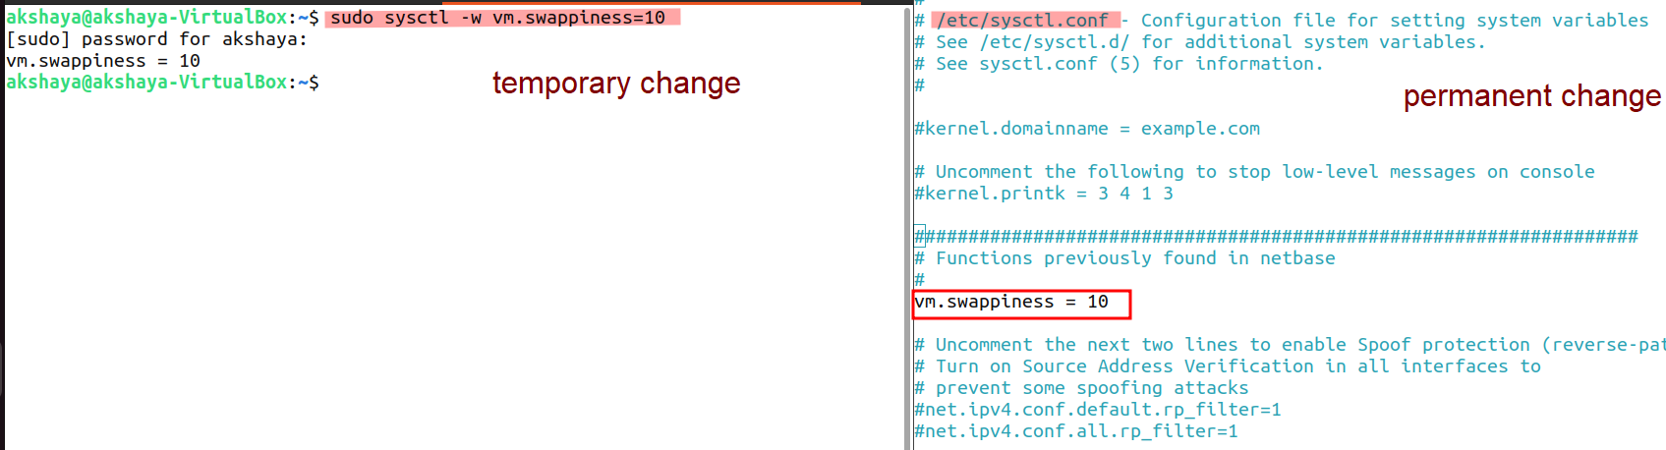
Modifying Kernel Parameters
Notes:
Swappiness is a setting in the Linux kernel that controls how aggressively the system uses swap space. It determines how often the system will move data from RAM to swap space.

Slide 11

Step 3 - Applying Changes and Monitoring
Applying Changes:
Apply permanent changes with sudo sysctl -p to load new settings from /etc/sysctl.conf.
Monitoring System Performance:
Use tools like top, vmstat, iostat, and netstat to observe the impact of your changes.
Adjust parameters as needed based on system behavior.
Notes:
Swappiness is a setting in the Linux kernel that controls how aggressively the system uses swap space. It determines how often the system will move data from RAM to swap space.

Slide 12
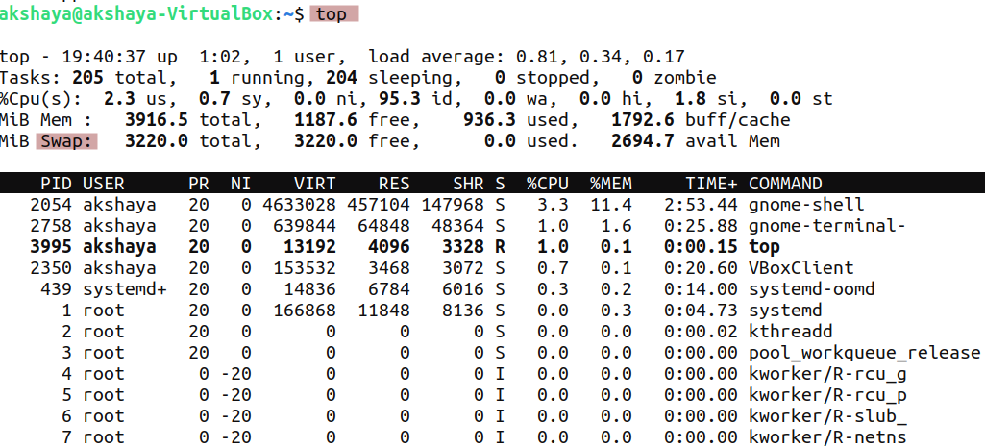
Monitoring
Notes:
Swappiness is a setting in the Linux kernel that controls how aggressively the system uses swap space. It determines how often the system will move data from RAM to swap space.

Slide 13
Key Kernel Parameters to Tune
File Descriptors Limit:
Linux systems limit the number of open files a process can have.
Increasing file descriptors can improve performance in high-demand environments like web servers.
Example: In /etc/sysctl.conf, add:
fs.file-max = 2097152
Disable unnecessary kernel modules or services, such as IPv6 (if unused), to free system resources.
Disable IPv6 by adding the following lines to /etc/sysctl.conf:
net.ipv6.conf.all.disable_ipv6 = 1
Adjust the scheduler to prioritize key processes, allowing better CPU utilization.
Use sysctl to tune the process scheduling parameters:
vm.dirty_ratio =10 (Controls when processes write to disk)
Disable Unused Kernel Features:
Kernel Scheduler Tuning:
net.ipv6.conf.default.disable_ipv6 = 1
Notes:
Swappiness is a setting in the Linux kernel that controls how aggressively the system uses swap space. It determines how often the system will move data from RAM to swap space.

Slide 14

Introduction to CPU Tuning
CPU tuning involves adjusting CPU behavior and scheduling policies to optimize performance, resource allocation, and power usage.
Benefits of CPU Tuning:
Improved multi-tasking.
Reduced power consumption on idle or low workloads.
Better performance for resource-intensive applications.

Slide 15
Monitoring CPU Utilization with Tools
top
Provides real-time information about CPU usage, processes, and memory.
View CPU utilization by pressing 1 to show per-core activity.
top
htop
Interactive process viewer with a more intuitive interface than top.
Shows CPU usage across cores, load average, and detailed process information.
Install and run:
htop
mpstat
Part of the sysstat package, mpstat provides detailed CPU utilization statistics across cores.
Command to display CPU usage:
mpstat -P ALL 1
sar
Another tool from the sysstat package for historical CPU usage data.
Command:
sar -u 1 3
Command:

Slide 16
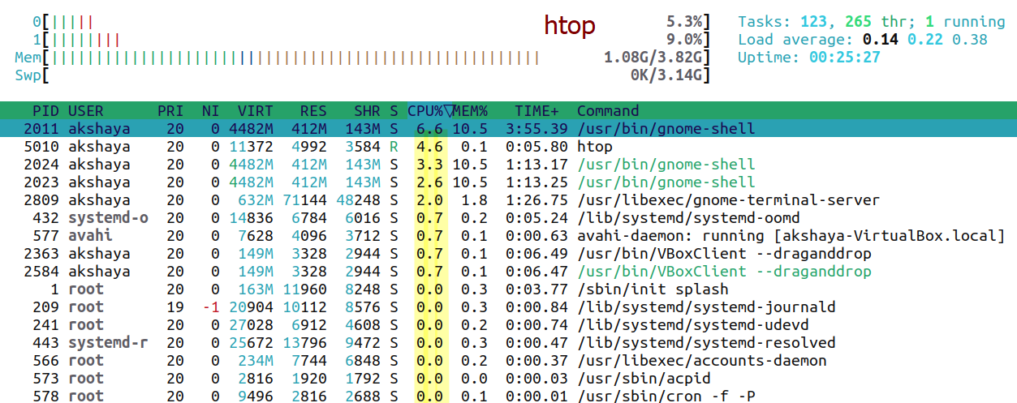
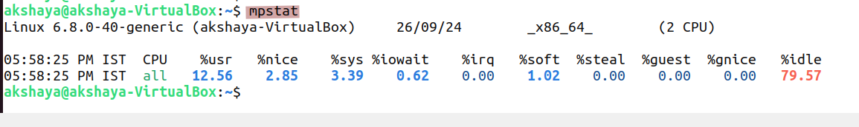
CPU Tuning and Optimization

Slide 17
CPU Frequency Scaling and Tuning with cpupower
CPU governors manage this:
Performance: Runs the CPU at maximum speed.
Powersave: Reduces CPU frequency to conserve energy.
Ondemand: Adjusts frequency based on the current load.
Tuning with cpupower:
cpupower allows you to monitor and change CPU frequencies and governors.
To install cpupower:
sudo apt install linux-tools-common linux-tools-$(uname -r) OR sudo yum install kernel-tools
Example command to change to the performance governor:
sudo cpupower frequency-set -g performance
Checking CPU Frequency:
Check the current frequency :
cpupower frequency-info
CPU Frequency Scaling:
Modern CPUs can dynamically adjust their frequency based on the system load to save power or boost performance.
Notes:
Limitations in Virtual Environments
Virtual Machines, especially on platforms like VirtualBox or KVM, often limit direct control over CPU scaling.
In such cases, the command cpupower frequency-info may show:
"No or unknown cpufreq driver is active on this CPU".
This indicates the host system is managing the CPU, and the guest has no direct access to scale frequency.

Slide 18
CPU Scheduling and Process Prioritization
Adjusting CPU Scheduling:
Linux provides tools to set the priority of processes for CPU time:
nice/renice: Change the priority (niceness) of a process.
taskset: Assign a process to specific CPU cores (CPU affinity).
Using nice and renice:
The niceness of a process controls its priority. Lower values mean higher priority.
Example: Start a process with a lower priority using nice:
nice -n 10 [command]
Modify the priority of a running process with renice:
renice -n 5 -p [PID]
Setting CPU Affinity with taskset:
taskset allows you to bind processes to specific CPU cores, helping with CPU load balancing.
Example: Run a process on CPU core 0:
taskset -c 0 [command]

Slide 19
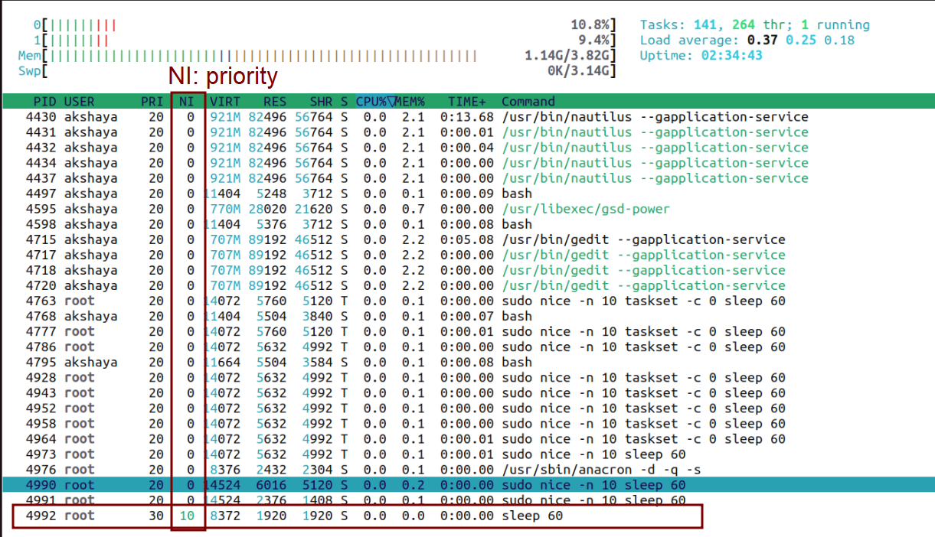
CPU Scheduling and Process Prioritization

Slide 20
Reducing CPU Load and Monitoring Usage
Identify and Kill Unnecessary Processes:
Use top, htop, or ps to identify high CPU usage processes.
Kill processes with kill or killall:
kill [PID] (Kill a specific process) killall [process_name](Kill all processes with the same name)
Monitor Load Average:
Load average indicates how many processes are waiting for CPU time.
Use uptime or top to check the load average:
uptime
Keep load average below the number of CPU cores to prevent CPU saturation.

Slide 21

Memory Management and Optimization
Memory management involves optimizing RAM usage to improve system performance.
Effective tuning can minimize swapping, enhance speed, and reduce resource wastage.
Why Tune Memory?
To improve system performance, reduce latency, and ensure efficient utilization of resources.

Slide 22
Memory Management Techniques
Adjusting Swappiness
Swappiness controls how often the system swaps data to the disk.
Lower value means less swapping (more RAM usage):
sudo sysctl vm.swappiness=10
Managing Cache Pressure
vm.vfs_cache_pressure controls the tendency of the system to reclaim memory used for caching.
Example:
sudo sysctl vm.vfs_cache_pressure=50

Slide 23
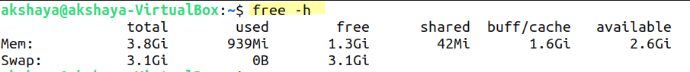
Tools for Memory Management Monitoring
free: Display RAM and swap usage.
free -h
vmstat: Report memory, processes, and paging.
vmstat 1 5
top / htop: Real-time monitoring of memory and process usage

Slide 24

Network Performance Tuning
Why Tune Network Performance?
Improve throughput, reduce latency, and handle more concurrent connections.
Key Parameters to Tune:
TCP Window Size: Adjust to manage the amount of data in transit.
sudo sysctl net.ipv4.tcp_window_scaling=1
Reduce SYN Backlogs: Decrease the number of half-open connections.
sudo sysctl net.ipv4.tcp_max_syn_backlog=4096

Slide 25
Network Monitoring Tools
iftop:
sudo iftop
netstat:
netstat -an
ping and traceroute:
Real-time bandwidth usage monitoring per network interface.
Display network connections, routing tables, and interface statistics.
Test connectivity and identify latency or packet loss issues.
Notes:
Swappiness is a setting in the Linux kernel that controls how aggressively the system uses swap space. It determines how often the system will move data from RAM to swap space.

Slide 26
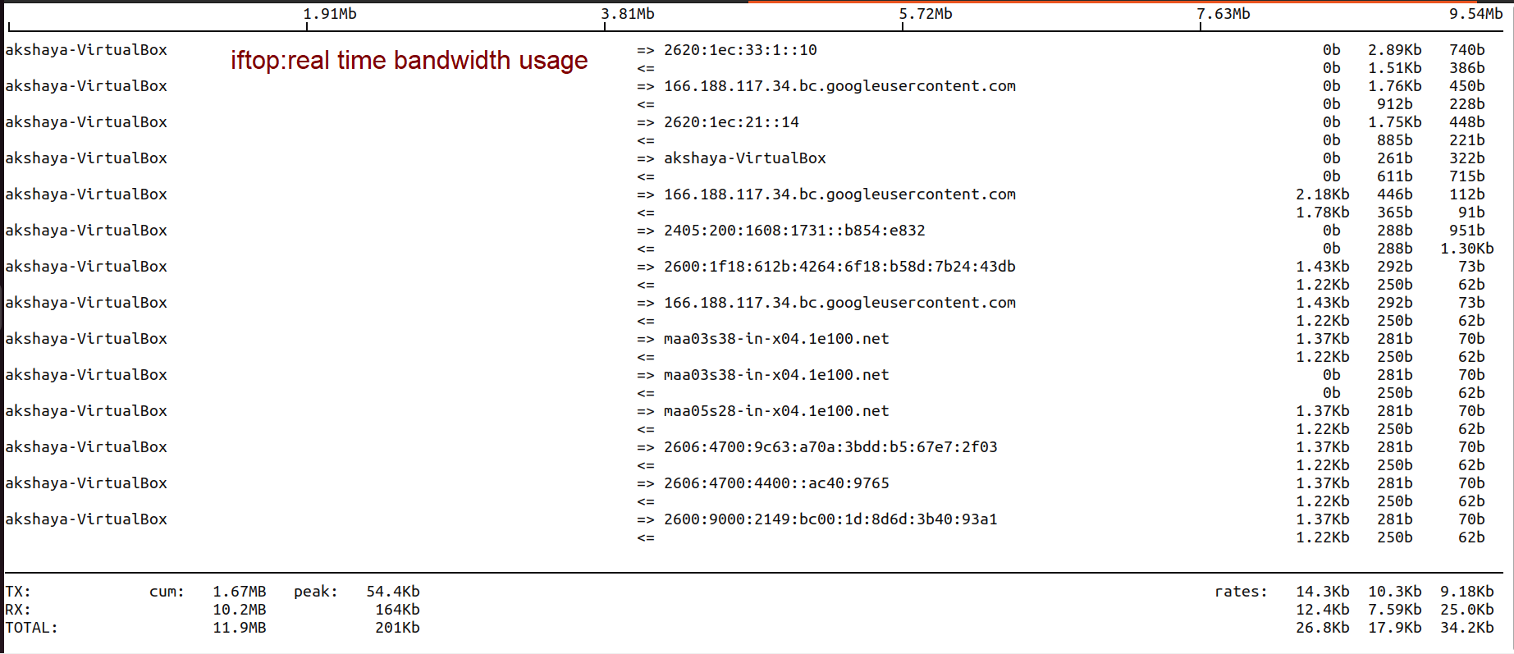
Network Monitoring Tools
Notes:
Swappiness is a setting in the Linux kernel that controls how aggressively the system uses swap space. It determines how often the system will move data from RAM to swap space.

Slide 27
Network Optimization Techniques
TCP Congestion Control:
Use bbr for high-bandwidth, high-latency connections.
sudo sysctl net.ipv4.tcp_congestion_control=bbr
Increase Connection Backlog:
Improve handling of simultaneous connections by increasing backlog limits.
sudo sysctl net.core.somaxconn=1024
Modify for better throughput in different network conditions.
Notes:
Swappiness is a setting in the Linux kernel that controls how aggressively the system uses swap space. It determines how often the system will move data from RAM to swap space.

Slide 28

Filesystem Optimization
What is Filesystem Optimization?
The process of tuning filesystem parameters and layout to improve data access times, read/write performance, and overall system efficiency.
Why Optimize Filesystem?
Enhances disk performance, reduces fragmentation, and speeds up file access, especially in large and busy systems.
Notes:
Swappiness is a setting in the Linux kernel that controls how aggressively the system uses swap space. It determines how often the system will move data from RAM to swap space.

Slide 29
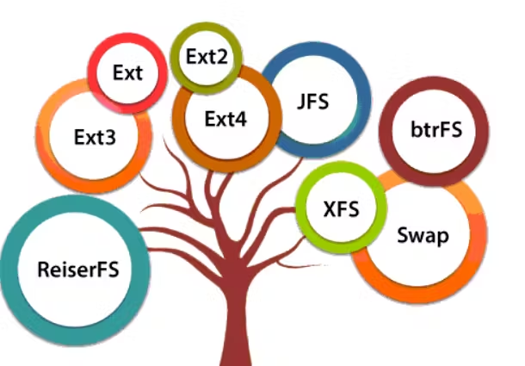
Filesystem Types and Selection
Choosing the Right Filesystem:
Different filesystems have different strengths.
ext4: Good general-purpose filesystem, supports journaling.
XFS: Better for handling large files, often used in enterprise settings.
btrfs: Advanced features like snapshots and error detection.
Use Case-Based Selection:
For reliability: ext4 or XFS.
For advanced features and scalability: btrfs.
Notes:
Swappiness is a setting in the Linux kernel that controls how aggressively the system uses swap space. It determines how often the system will move data from RAM to swap space.

Slide 30
Mount Options for Performance
Using Optimal Mount Options:
noatime: Disables recording of last access times, reducing unnecessary write operations.
mount -o noatime /dev/sda1 /mnt
data=writeback: Can improve performance by deferring metadata updates.
nodiratime: Similar to noatime, but applies specifically to directories.
Tuning Journal Settings:
Journal mode tuning (e.g., data=journal, data=ordered) can impact both performance and reliability.
Notes:
Swappiness is a setting in the Linux kernel that controls how aggressively the system uses swap space. It determines how often the system will move data from RAM to swap space.

Slide 31
Filesystem Maintenance for Optimization
Defragmentation:
ext4: Use e4defrag to defragment ext4 filesystems and improve performance.
sudo e4defrag /dev/sda1
Filesystem Checks:
Use fsck to identify and fix errors that may degrade performance.
sudo fsck /dev/sda1
Reducing Fragmentation:
Regular maintenance to prevent excessive fragmentation, particularly important for filesystems that don’t handle fragmentation well.
Notes:
Swappiness is a setting in the Linux kernel that controls how aggressively the system uses swap space. It determines how often the system will move data from RAM to swap space.

Slide 32

Best Practices for Filesystem Optimization
Partitioning:
Separate partitions for frequently accessed directories (e.g., /var, /home) to reduce fragmentation.
Use Logical Volume Management (LVM):
Flexible resizing and easier management of disk space can improve performance.
Filesystem Alignment:
Ensure partition alignment matches the underlying disk block size to prevent performance degradation.
Notes:
Swappiness is a setting in the Linux kernel that controls how aggressively the system uses swap space. It determines how often the system will move data from RAM to swap space.

Slide 33
Filesystem Optimization Tools
tune2fs: Tune ext2/ext3/ext4 filesystems by adjusting reserved blocks, mount count, etc.
sudo tune2fs -m 1 /dev/sda1 (Set reserved blocks to 1%)
iostat: Monitor I/O performance to identify bottlenecks.
iostat -x 1
iotop: Monitor disk I/O usage by processes in real time.
Notes:
Swappiness is a setting in the Linux kernel that controls how aggressively the system uses swap space. It determines how often the system will move data from RAM to swap space.

Slide 34

Maintenance and Troubleshooting

Slide 35

Maintenance Overview
Introduction to Maintenance:
Essential to keep systems running smoothly.
Ensures security, performance, and reliability.
Key Components:
System updates.
Log management.
Backup and recovery.
Troubleshooting techniques.

Slide 36

Updating System Packages
Updating System Packages:
Regular updates are crucial to keep security patches current.
Use package managers like apt, yum, or dnf.
Check for Pending Updates
sudo apt list --upgradable (Debian/Ubuntu)
sudo yum check-update (CentOS/RedHat)
sudo dnf check-update (Fedora/RedHat)
Best Practices:
Test updates in a non-production environment.
Review release notes to assess potential impacts.

Slide 37
Updating System Packages
Update a Specific Software
sudo apt install --only-upgrade <package_name>
sudo yum update <package_name>
sudo dnf upgrade <package_name>
Automate package updates using cron jobs to run update commands at specific intervals.
Install and configure unattended-upgrades (Debian/Ubuntu) to automatically download and install security updates:
sudo apt install unattended-upgrades
Automate System Updates
sudo dpkg-reconfigure unattended-upgrades

Slide 38
Log Management
Track system activities, errors, and suspicious behavior.
Log Types:
System Logs: Kernel, syslog, messages.
Application Logs: Logs generated by services like Apache, MySQL.
Tools for Log Management:
rsyslog or syslog-ng for centralized logging.
Logrotate to automate log rotation and prevent disk space exhaustion.
Use monitoring tools like ELK Stack for log analysis.
Best Practices:
Regularly review logs for anomalies.
Set up alerts for critical events.

Slide 39
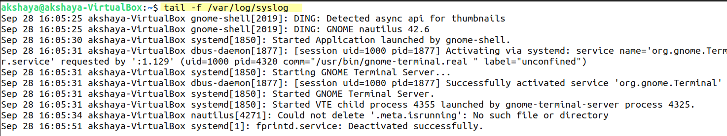

Slide 40
Backup and Recovery
Importance of Backups:
Protect data against loss from hardware failures, user errors, or cyber-attacks.
Backup Strategies:
Full Backups: Backup everything, takes longer but provides complete copies.
Incremental and Differential Backups: Faster, storing only changes since the last backup.
Scheduling Backups:
Use tools like cron or rsync to automate backups.
Recovery:
Practice recovery periodically to ensure backups work.
Store backups in multiple locations to prevent total loss.

Slide 41
Troubleshooting Techniques
Identifying Issues from Logs
Log Files as Primary Source:
Logs are crucial for diagnosing and resolving issues.
Common log files to check include:
System Logs (/var/log/syslog or /var/log/messages): General system activities and errors.
Authentication Logs (/var/log/auth.log): Details on authentication attempts, useful for security-related issues.
Application Logs (e.g., Apache: /var/log/apache2/error.log): Specific application errors.
Commands for Log Checking:
tail -f /var/log/syslog: Real-time monitoring of system logs.
grep: Extract specific errors from logs:
grep "error" /var/log/syslog

Slide 42
Boot-Related Issues and Logs
Kernel and Boot Logs:
Boot issues often stem from kernel misconfigurations or hardware problems.
Logs to Check:
/var/log/boot.log: Contains information from system boot.
dmesg: Displays kernel-related messages, useful for identifying hardware or driver issues.
Common Boot Problems:
Bootloader Issues: Failure in GRUB configuration might prevent the system from booting.
Solution: Boot into a live CD and fix GRUB using: sudo grub-install /dev/sda
Kernel Panics: Investigate /var/log/kern.log or dmesg to understand what caused the kernel panic.

Slide 43
Applications for Troubleshooting
System Monitoring Tools:
top/htop: Monitor running processes, CPU, and memory usage in real-time.
vmstat, iostat: Analyze system performance and identify I/O bottlenecks.
Network Troubleshooting:
ping: Check connectivity to a network resource.
traceroute: Track the route packets take to reach a destination.
netstat or ss: View active connections and open ports to troubleshoot networking issues.
Disk and Filesystem Issues:
df -h: Check disk space usage to avoid issues related to full partitions.
fsck: Filesystem check and repair tool, useful when a system fails to mount a partition.
General Debugging Tools:
strace: Trace system calls made by a process. Useful for debugging application issues: strace -p <process_id>
lsof: List open files and network connections, helping identify which processes are using resources.

Slide 44

Threat Model & Protection Method

Slide 45

Linux Threats
Common Linux Threats
Unauthorized Access: Attackers attempting to gain access via brute force or exploiting weak passwords.
Privilege Escalation: Exploiting software vulnerabilities to gain root or admin privileges.
Malware: Malicious software, including rootkits, Trojans, and worms targeting Linux systems.
Network-Based Threats: DDoS attacks or MITM (Man-in-the-Middle) attacks targeting Linux servers.

Slide 46
Vulnerabilities in Linux Systems
Unpatched Software: Running outdated software leaves systems vulnerable to known exploits.
Weak Configuration: Misconfigured services, open ports, or weak firewall rules.
Exposed Services: Publicly exposed services without proper authentication or encryption.

Slide 47
OS Hardening, WHY ?
Protect Sensitive Data: Hardening helps secure sensitive information from unauthorized access and breaches.
Reduce Vulnerabilities: By minimizing unnecessary features and services, we lower the number of potential entry points for attackers.
Enhance System Stability: A well-configured OS is less likely to experience crashes or performance issues caused by misconfigured settings.
Compliance: Many industries have regulatory requirements that mandate certain security measures, including OS hardening.
Prevent Exploits: Regular updates and security patches protect against known vulnerabilities, reducing the risk of exploitation.
Build Trust: A secure environment fosters trust among users and stakeholders, as it demonstrates a commitment to protecting data and privacy.
Improve Incident Response: With better security measures in place, organizations can respond more effectively to potential security incidents.

Slide 48
Key Points of OS Hardening
Reduce Attack Surface: Focus on minimizing potential entry points for attackers.
Disable Unnecessary Services: Turn off services and features that are not needed.
Enforce Security Policies: Set rules for user access and behavior to enhance security.
Apply Security Patches: Regularly update the OS and software to fix vulnerabilities.
Install Essential Software Only: Keep only necessary applications to limit risks.
Set Strong User Permissions: Ensure users have only the access they need.
Implement Firewalls: Use firewalls to control incoming and outgoing network traffic.
Enable Logging: Activate logging to monitor system activities and detect issues.
Use Intrusion Detection Systems (IDS): Employ tools to identify unauthorized access.
Educate Users: Train users on security best practices, like spotting phishing attacks.
Create a Secure Environment: Focus on overall security to protect data and minimize risks.

Slide 49
Key Steps for OS Hardening​:
Minimize Services: Disable unnecessary services and processes to reduce potential entry points.
Secure SSH Access: Disable root login and use key-based authentication.
Firewall Configuration: Use tools like iptables or ufw to restrict access to services.
File Permissions: Use strict file permissions to prevent unauthorized users from modifying sensitive files.
Update System: Regularly apply security patches and updates.

Slide 50

Lynis Tool for Threat Analysis
Lynis is an open-source security auditing and vulnerability scanning tool for Unix-based systems, including Linux.
It helps identify security vulnerabilities, system misconfigurations, and compliance issues.

Slide 51
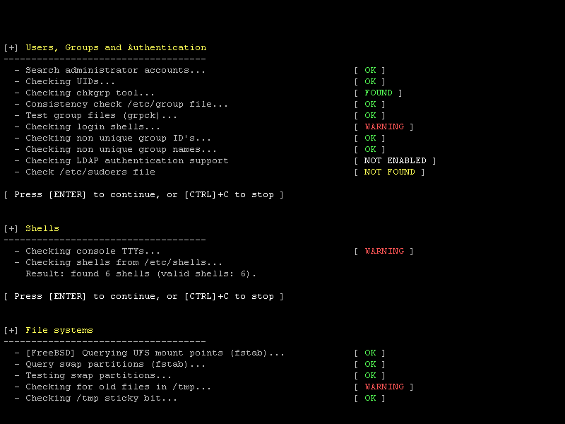

Slide 52
To Install Lynis:​
sudo apt install lynis​ or sudo yum install lynis​
Alternatively, you can download it from the official repository: git clone https://github.com/CISOfy/lynis.git​ cd lynis​ ​
Running an Audit with Lynis​
Start a System Audit: sudo lynis audit system​ ​
Audit Output:
Lynis will generate a detailed audit report highlighting system vulnerabilities and giving hardening recommendations.
Interpreting Lynis Results :
Lynis provides detailed output that lists each check, its result, and a severity score. Review warnings and suggestions at the end of the report for prioritized actions to improve system security.

Slide 53

Lynis Tool
Detailed Audits: Checks various parts of your system for security issues.
Flexible Plugins: Uses add-ons to customize checks for different applications.
Security Tips: Provides easy-to-follow advice to improve security.
Compliance Checks: Helps you meet industry security standards and regulations.
Clear Reports: Gives you straightforward reports on vulnerabilities and fixes.
Low Impact: Runs without slowing down your system significantly.
Customizable Tests: You can turn certain checks on or off to fit your needs.
Integration Friendly: Works well with other security tools for better protection.
Regular Updates: Keeps getting better with updates that add new checks.
Community Help: Supported by a community that shares resources and advice.

Slide 54
Thank You & Any Question

